Slide 1
Employee Data Analysis using Excel
STUDENT NAME: AKILA.K
REGISTER NO: 312216756
DEPARTMENT: B.COM(ACCOUNTINF & FINANACE)
COLLEGE: SHRI KRISHNASWAMY COLLEGE FOR WOMEN

Slide 2
PROJECT TITLE
Employee Performance Analysis using Excel

Slide 3


AGENDA
Problem Statement
Project Overview
End Users
Our Solution and Proposition
Dataset Description
Modelling Approach
Results and Discussion
Conclusion
3/21/2024 Annual Review

Slide 4

PROBLEM STATEMENT
The goal is to develop a comprehensive system to analyze employee performance using various metrics and data sources. This analysis will help identify high-performing employees, recognize areas where employees need improvement, and inform decisions related to promotions, training, and overall workforce management.

Slide 5

PROJECT OVERVIEW
To evaluate and enhance employee performance through data analysis, identifying key metrics and providing insights for improvement. Analysing a performance of employee by considering various factors like, metrics, Gender, Performance score, rating.
Improved understanding of performance trends, identification of High, Mid, and Low performance, and actionable insights to support training, development, and overall productivity enhancement.
.

Slide 6


WHO ARE THE END USERS?
HR Managers and Teams
Team Leaders and Supervisors
Performance Improvement Consultants
Data Analysts and Business Intelligence Teams
Senior Managements and Executives
Employee

Slide 7

OUR SOLUTION AND ITS VALUE PROPOSITION
Conditional formatting – Missing
Filter – Remove
Formula – Performance
Pivot – summary
Graph – Data visualization

Slide 8
Dataset Description
Employee – kaggle
9 features
Employee I'd numerical
Name-Text
Employee Type
Performance Level
Gender- Male, Female
Employee Rating-Numerical values

Slide 9

THE "WOW" IN OUR SOLUTION
Performance Level=IFS(Z8>=5,”VERY HIGH”,Z8>=4,”HIGH”,Z8>=3,”MED”,TRUE,”LOW”
3/21/2024 Annual Review
9

Slide 10
MODELLING
Data Collection:
Downloaded using kaggle
Features collections:
Employee ID
First Name
Last Name
Gender
Employee Performance
Data cleaning:
Filled missing values and cleaned blank tabs using filters.
Performance level:
Using formulas the performance level is identified whether Very High, High, Medium, Low.
Pivot Table:
Using graphs the employee performance level shown. I looks like data visualization.
10

Slide 11
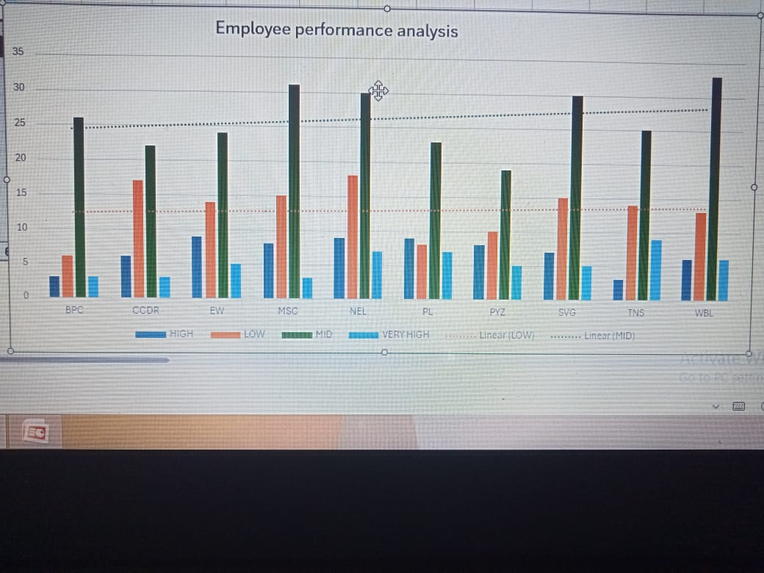
RESULTS
11

Slide 12
conclusion
In this dataset most of the employee performance is better. It is shown as pivot table by using column chart. To evaluate and enhance employee performance through data analysis, identifying key metrics and providing insights for improvement.

